Slide 1


HHH – THE RIDE APP
a Kings of code software package
Tim Haxton (lead), Cooper wolf, Jon scales
Iteration 4

Slide 2
About: HHH - The Ride app
HHH –The Ride App is a companion app for attendees and organizers of the Hotter'N Hell Hundred weekend biking event held annually in Wichita Falls, Texas.
This app is a primarily interactive system that allows users to register for events, view event schedules, local information, & route maps, as well as contact support personnel.
The app maintains a database of users and ride participants with their associated registration information.

Slide 3
Use cases – list
UC01: View events (Actor: User, System: HHH – The Ride App)
UC02: Set calendar event (Actor: User, System: HHH – The Ride App)
UC03: View tradeshow vendor list (Actor: User, System: HHH – The Ride App)
UC04: View map (Actor: User, System: HHH – The Ride App)
UC05: View HHH route maps & tracker (Actor: User, System: HHH – The Ride App)
UC06: View local information guide links (Actor: User, System: HHH – The Ride App)
UC07: Register for ride event (Actor: User, System: HHH-The Ride App)

Slide 4
Use cases – list
UC08: Contact SAG (Actor: Participant, System: HHH – The Ride App)
UC09: View on-site registration database (Actor: Volunteer, System: HHH – The Ride App
UC10: Assign rider bib number (Actor: Volunteer, System: HHH- The Ride App)
UC11: Respond to SAG request (Actor: Volunteer, System: HHH- The Ride App)
UC12: Volunteer login (Actor: Volunteer, System: HHH- The Ride App)
UC13: Create profile (Actor: User, System: HHH- The Ride App)

Slide 5
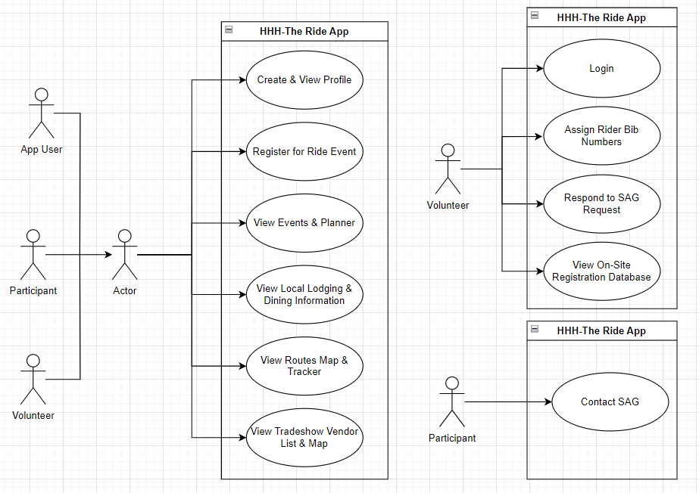
Abstract use case diagram

Slide 6
High-level use cases
UC01: View Events
TUCBW user clicks Maps, Info, & Events button
TUCEW user sees race & ride start times, venue event times, or consumer show hours
UC02: Set Calendar Event
TUCBW user clicks a set calendar icon for an event
TUCEW user saves calendar event and returns to HHH – The Ride App
UC03: View Consumer Show Vendor List
TUCBW user clicks Maps, Info & Events button
TUCEW user sees the list of consumer show vendors

Slide 7
High-level use cases
UC04: View Map
TUCBW user clicks Maps, Info & Events button
TUCEW user sees MPEC parking map, RV parking map, or start line map
UC05: View Route Maps & Tracker
TUCBW user clicks Maps, Info & Events button
TUCEW user sees the selected map
UC07: Register for ride event
TUCBW user clicks On Site Registration button
TUCEW user sees the Payment page

Slide 8
High-level use cases
UC08: Contact SAG
TUCBW participant clicks Call SAG button
TUCEW participant dials the SAG dispatch center
UC09: View On-site Registration Database
TUCBW volunteer clicks View Riders List button
TUCEW volunteer views the database web page

Slide 9
Project Plan
Use Case | Iteration #1 | Iteration #2 | Iteration #3 | Iteration #4
UC01 |  | X
UC02 |  |  |  | X
UC03 |  |  | X
UC04 |  | X
UC05 |  |  | X
UC07 |  | X
UC08 |  |  | X
UC09 |  |  |  | X

Slide 10
Decision tables
Req | Action | Business Process? | Begin w/ Actor? | End w/ Actor? | Useful Task for Actor? | Is Use Case? | Actor | System
R4 | View Events | Y | Y | Y | Y | Y | User | HHH – The Ride App
R5 | Set Calendar Event | Y | Y | Y | Y | Y | User | HHH – The Ride App
R8 | View Vendor List | Y | Y | Y | Y | Y | User | HHH – The Ride App

Slide 11
Decision tables
Req | Action | Business Process? | Begin w/ Actor? | End w/ Actor? | Useful Task for Actor? | Is Use Case? | Actor | System
R8 | View Map | Y | Y | Y | Y | Y | User | HHH – The Ride App
R7 | View Route Maps & Tracker | Y | Y | Y | Y | Y | User | HHH – The Ride App
R1 | Register for Ride Event | Y | Y | Y | Y | Y | User | HHH – The Ride App

Slide 12
Decision tables
Req | Action | Business Process? | Begin w/ Actor? | End w/ Actor? | Useful Task for Actor? | Is Use Case? | Actor | System
R6 | Contact SAG | Y | Y | Y | Y | Y | Participant | HHH – The Ride App
R2 | View On-Site Registration Database | Y | Y | Y | Y | Y | Volunteer | HHH – The Ride App

Slide 13

Role-based partition
HHH – The App/User, Actor: User, Participant, Volunteer | HHH – The App/Participant, Actor: Participant | HHH – The App/Volunteer, Actor: Volunteer
UC01: View events UC02: Set calendar event UC03: View vendor list UC04: View map UC05: View route maps & tracker UC07: Register for ride event | UC08: Contact SAG | UC09. View on-site registration database

Slide 14
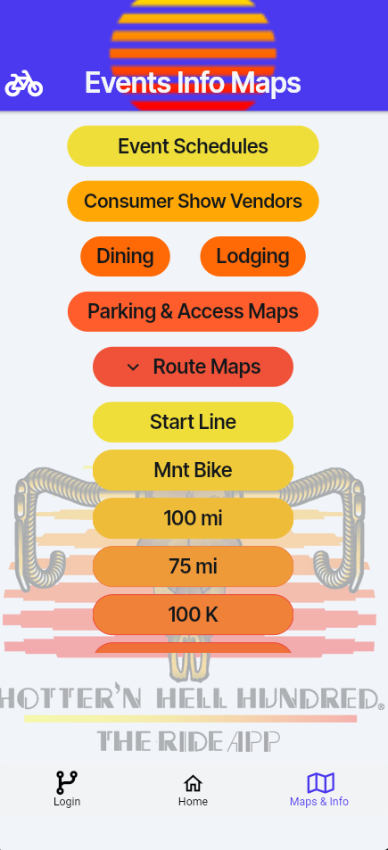
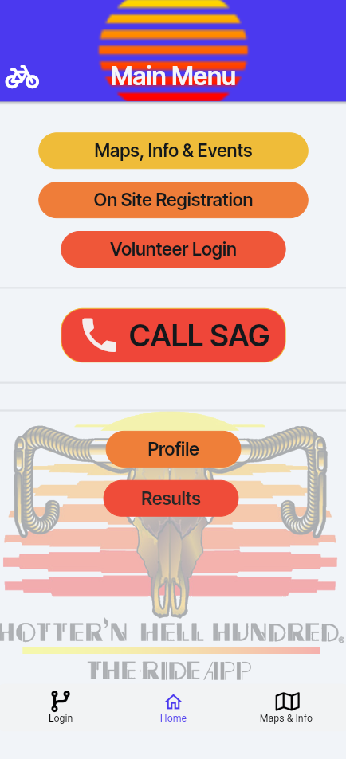
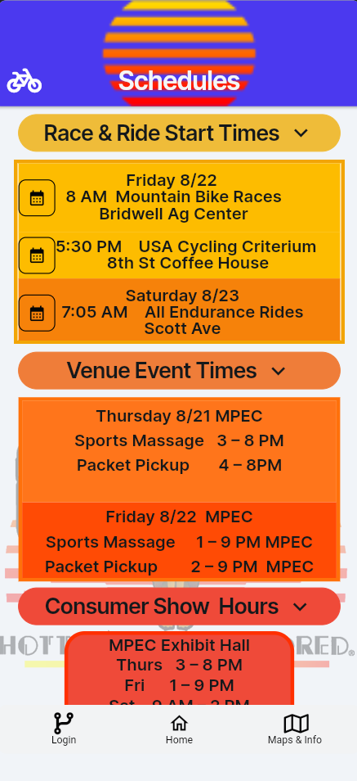
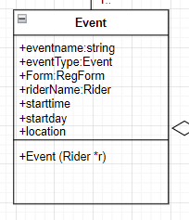
Expanded use cases
UC01: View Events
Precondition: User logged in and is a registered rider
Actor: User | System: HHH – The Ride App
 | 0) System displays Main Menu
1) TUCBW user clicks Maps, Info, and Events button | 2) The system displays the Events Info Maps page
3) The user clicks the Event Schedules button | 4) The system displays the Schedules page
5) The user clicks (a) the Race & Ride Start Times button or (b) the Venue Event Times button or (c) the Consumer Show Hours button | 6) The system displays a dropdown menu of (a) Race & Ride Start times or (b) Venue Event Times or (c) Consumer Show Hours
7) TUCEW the user sees the race and ride start times, venue event times, or consumer show hours
Postcondition: Rider receives information on events

Slide 15
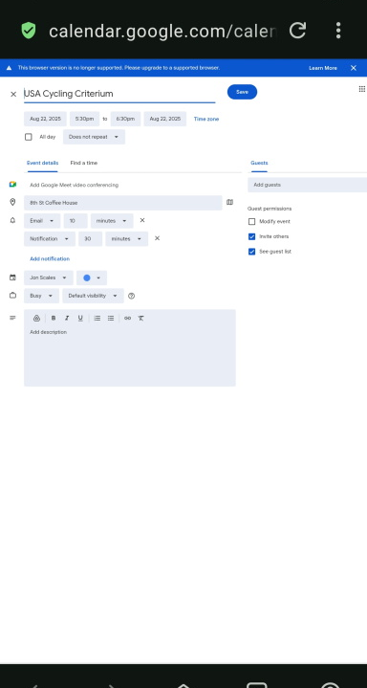
Expanded use cases (cont.)
UC02: Set Calendar Event
Precondition: User logged in and navigated to Schedules page
Actor: User | System: HHH – The Ride App
 | 0) System displays Schedules page
1) TUCBW user clicks Race & Ride Start Times dropdown button | 2) The system displays the list of race and ride start times with set calendar action icons
3) The user clicks the set calendar action icon for the desired event | 4) The system launches the mobile device calendar application and loads designated start day and time
5) TUCEW user saves calendar event and returns to HHH – The Ride App
Postcondition: Calendar event information is saved in google calendar

Slide 16
Expanded use cases
UC04: View Map
Precondition: User logged in and is a registered rider
Actor: User | System: HHH – The Ride App
 | 0) System displays Main Menu
1) TUCBW user clicks Maps, Info, and Events button | 2) The system displays the Events Info Maps page
3) The user clicks the Parking & Access Maps button | 4) The system displays the Map Viewer page
5) The user clicks (a) the MPEC parking map or (b) the RV parking map or (c) the Starting Line map | 6) The system displays (a) the MPEC parking map or (b) the RV parking map or (c) the Starting Line map
7) TUCEW the user sees the MPEC parking map or the RV parking map or the starting line map
Postcondition: User receives information on events

Slide 17
Incorrect Expanded use case
UC12: Login
Actor: Volunteer | System: HHH – The Ride App
 | 0) System displays Main Menu
1) TUCBW volunteer pressing “volunteer Login” button | 2) The system displays the Login page with username and password text fields and login button
3) The volunteer taps the username field | 4) The system launches the device keyboard overlay
5) The volunteer enters their username and taps “next” on the keyboard | 6) The system selects the next text field (password) for user to enter text
7) The volunteer enters their password and taps “done” on the keyboard and then the Login button | 8) The system submits the volunteer’s username and password to the database for validation (a) Login credentials are valid, and the Admin Site page is opened. (b) Login credentials are invalid TUCCW (UC14)
9) TUCEW the volunteer views the Admin Site page

Slide 18
Use cases, operations, & actions
Application | Use Case | Operations | Actions
HHH – The Ride App | UC01 View Events | Open Events Info Maps page Open Schedules page Open events dropdown menu | Click Maps, Info, and Events button Click Event Schedules button Click desired button on Event Schedules page
HHH – The Ride App | UC02 View Tradeshow Vendor List | Open Events Info Maps page Open Map Viewer page Open desired map | Click Maps, Info & Events button Click Parking & Access Maps button Click desired map icon

Slide 19
Scenario: use case 7 – register for event
UC07: Register for ride event
Actor: User | System: HHH – The Ride App
 | 0) System displays Main Menu
TUCBW user clicks On Site Registration button | 2) System displays the Register page
3) The user clicks the … ride choice | 4) System displays corresponding Registration page
5) The user enters form data & clicks the Sign Waiver button | 6) System accordingly displays a) Waiver Adult page or b) Waiver Child page
7) The user scrolls through the waiver and clicks TAP HERE | 8) System displays an agreement checkbox
9) The user clicks the checkbox | 10) System displays Submit Registration button
11) The user clicks the Submit Registration button | 12) System displays Payment page
13) TUCEW user sees the Payment page
5. User selects ride distance & enters phone number, city, zip code, age, sex, emergency contact name, emergency contact phone number then clicks Sign Waiver button. 6.1. The system GUI sends the form to the system controller 6.2. The system controller validates that all fields on the form are completed 6.3. The system controller calls the checkifAdult(a) function to update isAdult variable 6.4. If isAdult = true 6.4.1. The system controller navigates to the Waiver Adult page 6.5. Else, 6.5.1 The system controller navigates to the Waiver Minor page 6.6. The system GUI displays the Waiver Adult or Waiver Minor page to the user
NON-TRIVIAL

Slide 20
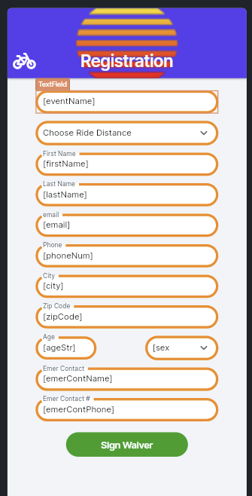
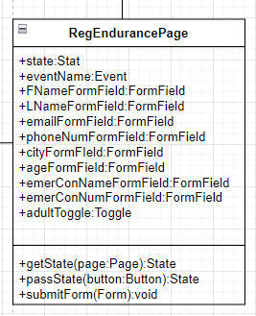
Scenario table: UC07
UC07: Register for ride event
# | Subject | Subject Action | Other Data/Objects | Object Acted Upon
5. | user | completes | Ride distance, phone number, city, zip code, age, sex, emergency contact name, emergency contact phone number | Registration Form
6.1. | system GUI | validates |  | Reg Form fields
6.2. | system controller | updates | main event, subevent | Event state variable
6.3. | system controller | updates | age | IsAdult state variable

Slide 21
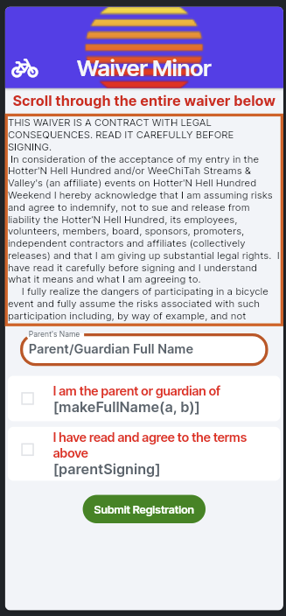
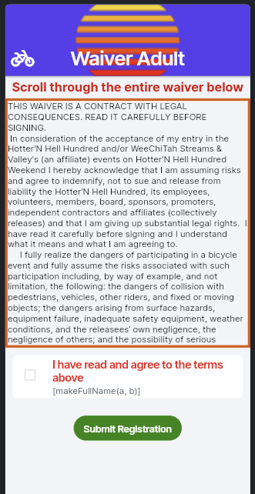
Scenario table: UC07
UC07: Register for ride event (cont'd-1)
# | Subject | Subject Action | Other Data/ Objects | Object Acted Upon
6.4. | if isAdult true
6.4.1. | system controller | navigates |  | waiverAdult page
6.5. | else
6.5.1 | system controller | navigates |  | waiverMinor page
6.6. | system GUI | displays |  | Appropriate waiver page

Slide 22
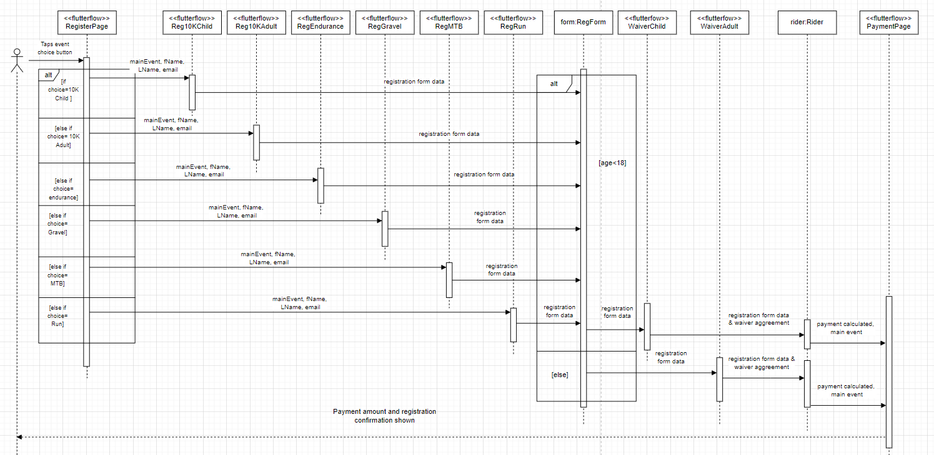
Registration Sequence diagram

Slide 23
Scenario – Use case 12 – volunteer login
UC12: Login
3. The volunteer enters their username and password and taps “done” on the keyboard and then the Login button 4.1. The system GUI submits the volunteer’s username and password to the system controller 4.2. The system controller validates the username and password with the system database 4.3. If the login credentials are valid 4.3.1. the system controller navigates to the Admin Site page 4.3.2. the system GUI displays the Admin Site page 4.4. else, 4.4.1. the system controller returns incorrect username or password message 4.4.2. the system GUI displays the message
Actor: Volunteer | System: HHH – The Ride App
 | 0) System displays Main Menu
TUCBW volunteer pressing “volunteer Login” button | 2) System displays Login page with username & password text fields, login button
3) Volunteer enters their username & password into textfields then presses login button | 4) The system submits volunteer’s username & password to database for validation a) Login credentials are valid, and the Admin Site page is opened. b) Login credentials are invalid
5) TUCEW the volunteer views the Admin Site page
NON-TRIVIAL

Slide 24
Scenario tables
UC12: Login
# | Subject | Subject Action | Other Data/Objects | Object Acted Upon
3. | volunteer | presses Login | Username, password | Login Button
4.1. | system GUI (login button) | submits | Username, password | database
4.2. | system controller | validates | Username, password | IsLoggedIn variable
4.3. | If login credentials valid
4.3.1. | system controller | navigates |  | Admin Site page
4.3.2. | system GUI | displays |  | Admin Site page
4.4. | else
4.4.1. | system controller | Returns | message | Login page
4.4.2. | System GUI | displays | message | Login page

Slide 25
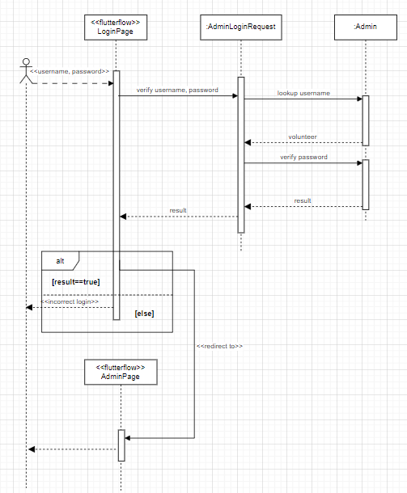
Volunteer login sequence diagram

Slide 26
Iteration 4 Accomplishments
Tim Haxton (Lead)
Cooper wolf
Jon scales
Use Case Diagrams
Scenario Tables
Partitions
Project Plan
Decision Tables
Use Case Diagrams
Prototypes
Use Case Diagrams
Sequence Diagrams
SRS document update

Slide 27
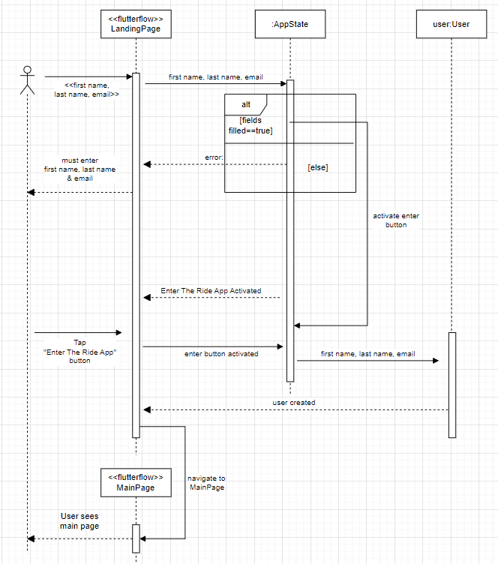
User sign in sequence diagram

